Slide 1


State Of Charge
Voltage over time for a discharging battery
Notes:
State of charge is the measure of much energy is stored in a battery and has important safety and stability implications. This short video will explore what state of charge means and why its important

Slide 2
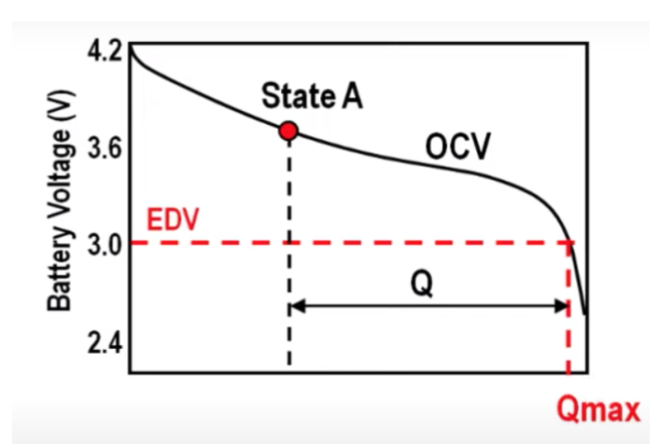
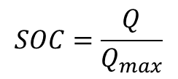
What is the State of Charge?
The state of charge refers to the ratio of charge remaining to the total charge capacity.
As the battery is discharged, the voltage produced by the battery changes
$$SOC=\frac{Q}{Q_{max}}$$
SOC = 1 (DOD = 0) for fully charged battery
SOC = 0 (DOD = 1) for fully discharged battery
Notes:
State of charge refers to the amount of charge left in the battery. This is typically expressed as a decimal or percentage. For a fully charged battery the SoC is 1, for a fully discharged battery the SoC is 0
Different types of batteries have different discharge curves

Slide 3
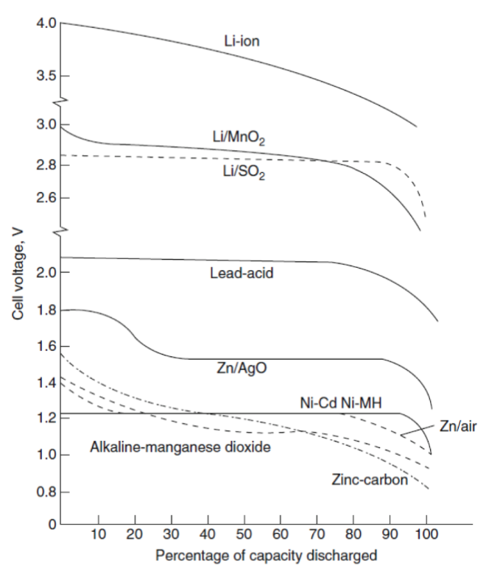
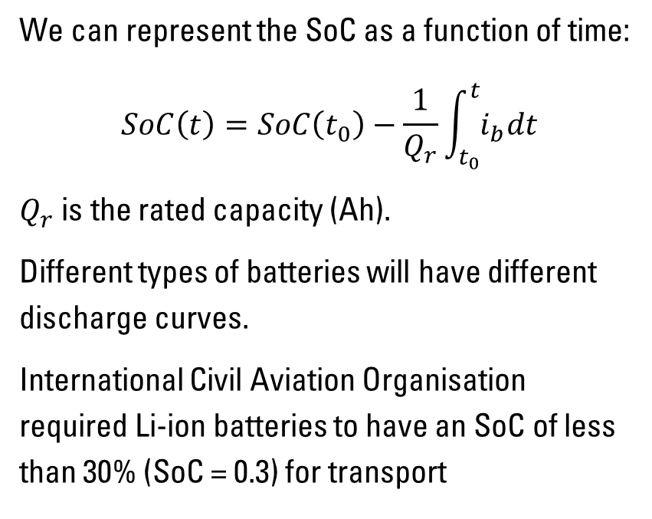
Discharge Curves
We can represent the SoC as a function of time:
$$SoC\left(t\right)=SoC\left(t_{0}\right)−\frac{1}{Q_{r}}\int_{t_{0}}^{t}{i_{b}dt}$$
$Q_{r}$ is the rated capacity (Ah).
Different types of batteries will have different discharge curves.
International Civil Aviation Organisation required Li-ion batteries to have an SoC of less than 30% (SoC = 0.3) for transport
Notes:
Discharge curves relate to the voltage the batteries produce when at a given capacity. Depending on the battery technology these will have different shapes.
We can represent the SoC as a function of time. Which is initial state of charge minus the change in SoC between initial time and t1. This is determined by the change in current over the maximum rated capacity of the battery.
Higher SoCs mean a battery has more energy stored, and are more unstable. Low SoCs of less than 30% are recommended for transport. Discharging a battery with a High SoC also causes the battery to become much hotter. Batteries are able to utilize more of their capacity at higher temperatures, but can become unstable and pose a combustion risk.

Slide 4
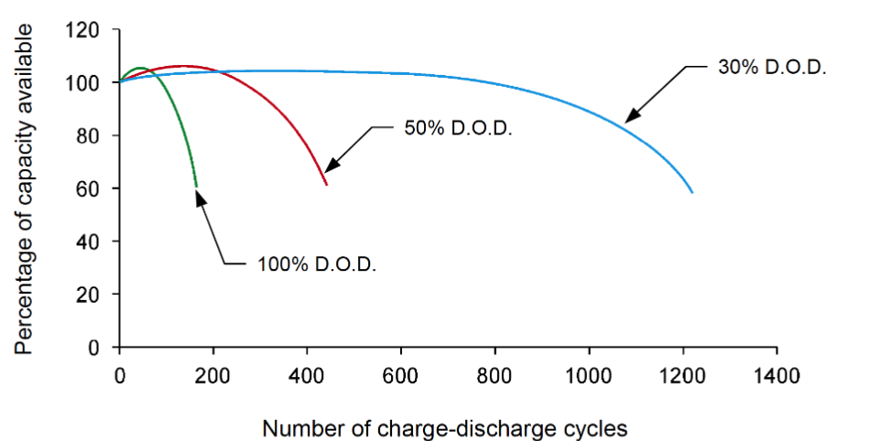
Depth of Discharge (DoD)
Refers to how much of the battery gets emptied for every cycle.
If a battery gets completely discharged at each cycle, its total number of cycles reduces. This reduces the battery’s lifespan.
This is important for portable devices such as phones.
Notes:
Depth of discharge refers to the amount the battery is discharged every cycle. The further the battery is discharged at the end of each cycle the greater the reduction in total cycles over the battery’s lifespan. Design of portable and rechargable devices revolves around utilizing the maximum capacity whilst minimizing cycle loss. State of charge must be carefully managed to ensure the batterys lifespan.

